Slide 1

TuneFlix
An innovative online web application designed to provide users with a seamless and immersive music and video streaming experience.

Slide 2

Team
Joy Oghenerukewve Notie
Oguoma Elvis
Jesse Okunogbe
Shelynna Adjana

Slide 3

Description
TuneFlix is an online web application for music and video streaming, eliminating the stress of visiting different applications for music and video streaming. With a sleek and user-friendly interface, it offers a wide range of features and content, making it the go-to platform for music and video enthusiasts.
TuneFlix aims to create a harmonious and engaging environment for music and video enthusiasts, fostering a sense of community and connection among its users. Whether you're a music aficionado or a cinephile, TuneFlix has something for everyone, making it the ultimate destination for online music and video streaming. Join us today and experience the world of TuneFlix!

Slide 4
Key Features:
1. Extensive Music Library:
- TuneFlix boasts an extensive music library, featuring various songs from different genres and artists.
- Users can explore new releases, and discover trending tracks.
2. High-Quality Video Streaming:
- Enjoy high-definition video streaming for videos, movies, tv shows, and web series.
- Users can adjust video quality based on their internet connection for uninterrupted viewing.

Slide 5

Learning Objectives
Technical Skills:
Backend Development:
Gain proficiency in server-side programming languages such as Python, Ruby, or Node.js or Django.
Understand web security best practices to protect user data and content.
Frontend Development:
Master frontend technologies like React, Angular, Vue.js, HTML, CSS, and JavaScript for building the user interface (UI).
Create responsive and user-friendly interfaces for music and video playback.
API Integration:
Gain the skills to integrate APIs for streaming, authentication, and payment processing.
Explore third-party APIs for music and video content, like YouTube's API or Spotify's API.

Slide 6

Technologies
Frontend:
HTML
CSS
JavaScript
SASS
Backend:
Python
Django

Slide 7

Third Services
Spotify API
Netflix API

Slide 8

Challenges Identified
Licensing and Copyright Issues:
Securing the rights to stream music and videos legally would be a complex and costly process.
Ensuring compliance with copyright laws and licensing agreements to avoid legal issues.
Content Delivery and Scalability:
Handling large volumes of media files and delivering them to users with low latency.
Scaling the infrastructure to accommodate increasing user demand and maintaining high availability.
Streaming Technology:
Implementing adaptive streaming algorithms to deliver the best quality based on users' network conditions and device capabilities.
Supporting various streaming protocols and formats (e.g., HLS, MPEG-DASH, VP9) for different devices.

Slide 9

Challenges Identified
User Experience (UX):
Providing a smooth and seamless user experience with fast load times and minimal buffering.
Ensuring compatibility with various browsers, operating systems, and devices.
Cross-Platform Compatibility:
Ensuring a consistent experience across various platforms, devices, and screen sizes.
Developing and maintaining native mobile apps for iOS and Android.

Slide 10

Work Schedule
Detailed schedule of work prepared with Trello boards accessible with the link below
Link to Trello board: https://trello.com/b/rNLIYcxl/tuneflix

Slide 11
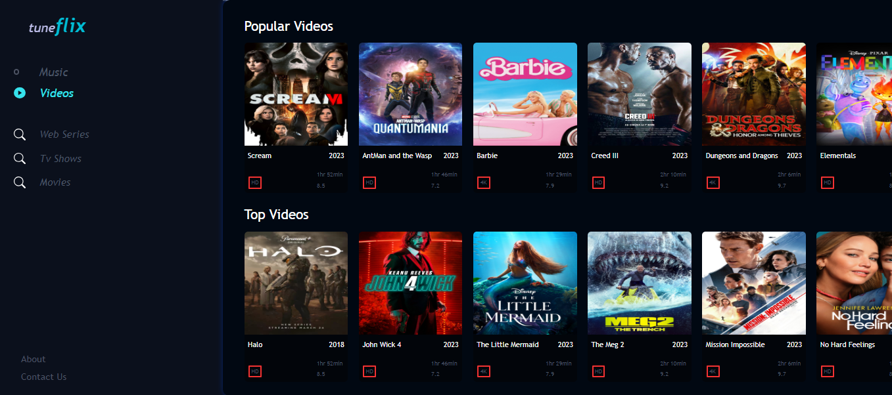
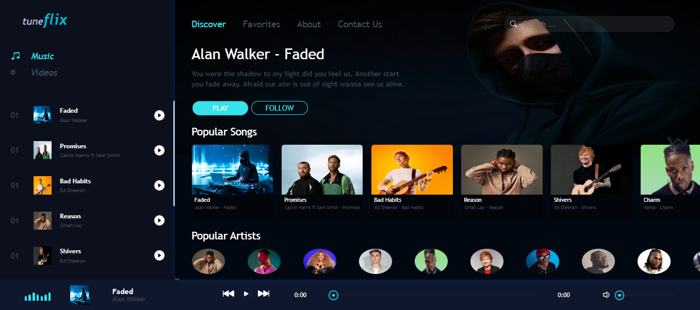
Mock-ups

